Slide 1
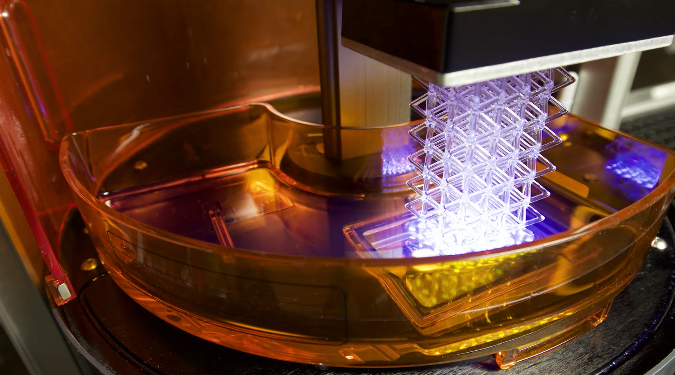

Functional Materials For Advanced Manufacturing
Raymond Weitekamp
raw@polyspectra.com
Notes:
Raymond Weitekamp, Founder of polySpectra. We’re making functional materials for advanced additive manufacturing.

Slide 2
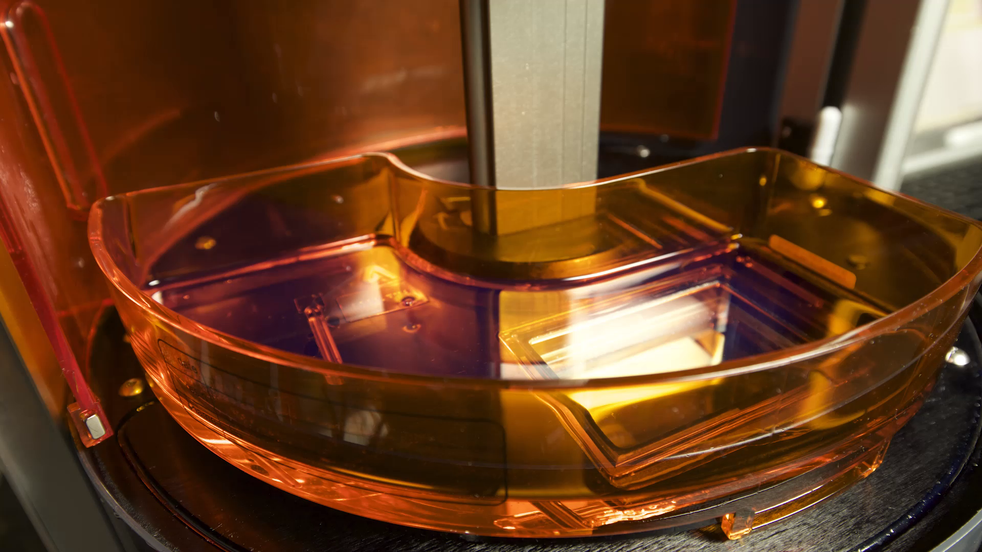
Ideas, materialized
Notes:
Imagine a world where you can materialize your ideas, from a dream to a physical object in a single step. Imagine a world where manufacturing was fast, generated no waste, required no minimum order size and no inventory. Imagine goo to gadget in one step.
How many of you have heard of 3D printing? (Everyone)
How many of you own something useful that was 3D printed? (none or 1)

Slide 3
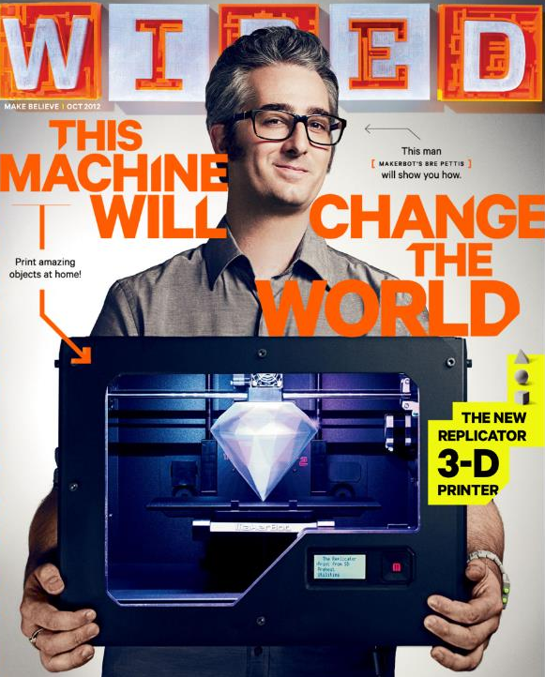
Problem
The Materials Suck
Notes:
The reason why you don’t own any 3D printed parts is that the materials suck. The beautiful future of democratized manufacturing promised to us in the recent 3D printing craze has not been delivered. So why didn’t the Makerbot change the world? Because of the incredibly limited materials set available to current 3D printers. While you can print any shape you can dream of, you’re stuck with cheap plastic toys. Manufacturing is an 11 trillion dollar industry, and yet additive manufacturing is less than one tenth of one percent of that – because we don’t yet have the right materials.

Slide 4






temperature
toughness
Notes:
Most 3D printable materials are incredibly brittle and deform at modest temperatures. Our first product is a resin capable of achieving both high toughness and high working temperature. Because we are using fundamentally different chemistry than the competition, we can achieve breakthrough materials properties. The combination of toughness and working temperature enables us to crush the competition.

Slide 5
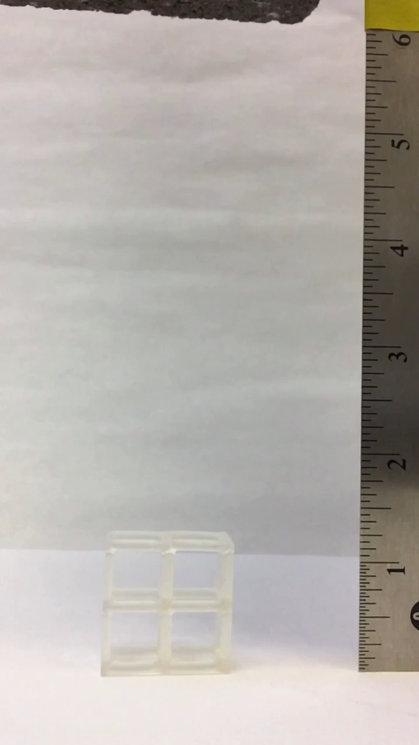
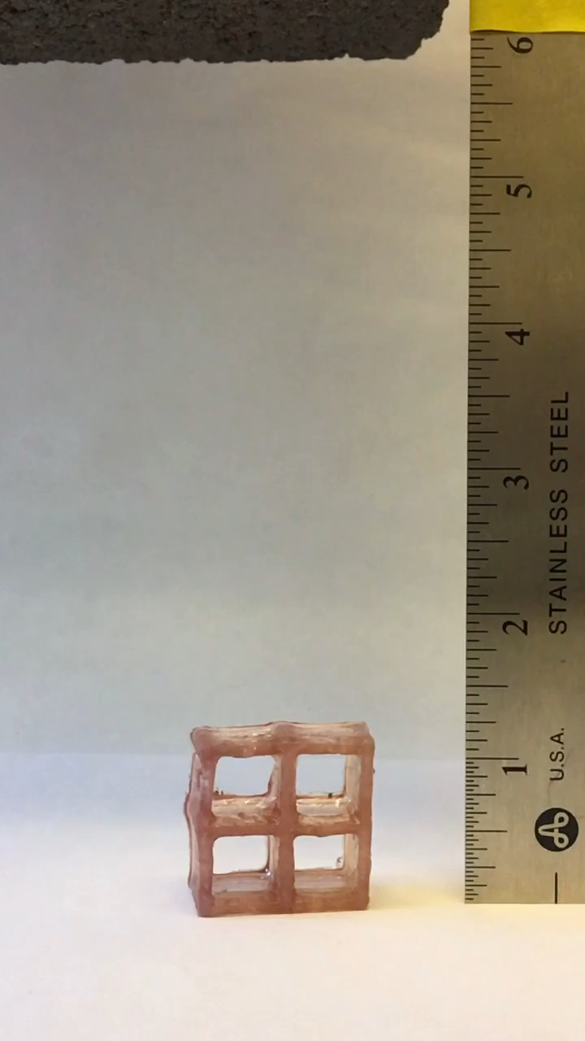
Standard Resin
Notes:
Here we are literally going to crush the competition, with a brick. polySpectra’s high strength materials enable direct 3D printing of rugged parts, relevant to a number of industries.

Slide 6
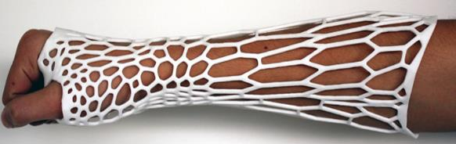
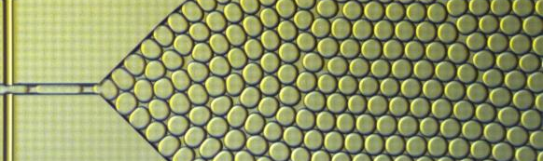
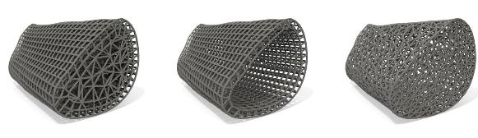
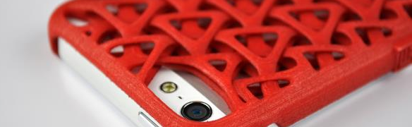
medical
Tailored
Materials
biotech
A Modular Manufacturing
Platform
aerospace
consumer electronics
Notes:
Our first brickproof product is just the beginning. Our core technology is a chemical platform capable of making tailored materials for a wide variety of applications. Our robust and versatile catalysts enable us to set the form and function of these advanced materials in a single step. This enables us to additively manufacture parts and devices for many different industries.
With polySpectra’s manufacturing platform, you can have any shape you can dream of, in any material you can dream of.

Slide 7
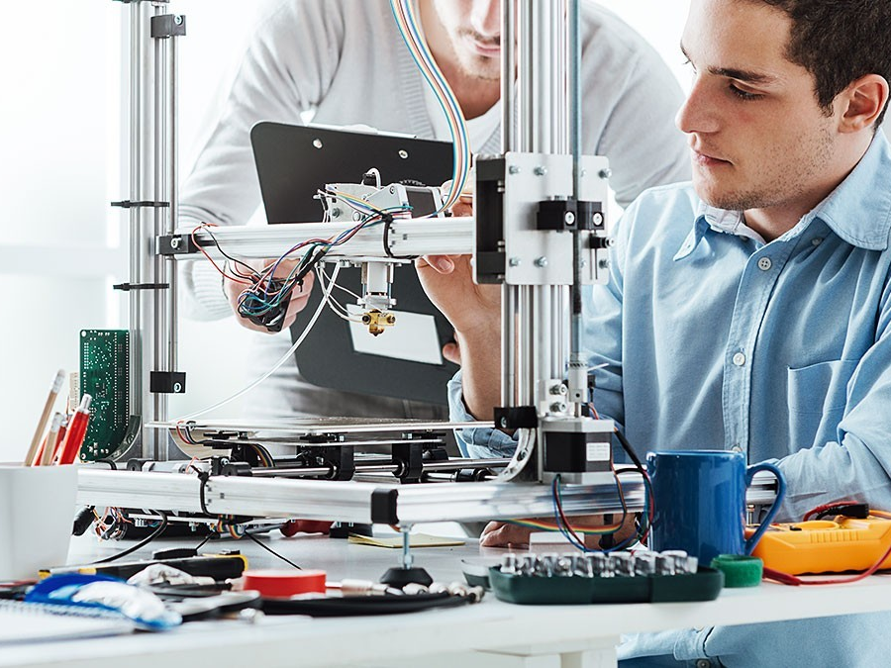
Opportunity
Additive Manufacturing
All Products
$2.4B
Materials
$800M
Notes:
Additive manufacturing is a rapidly growing market, and materials represent 1/3 of all product sales. polySpectra will leverage the existing printer infrastructure by selling advanced materials, generating a high-margin recurring revenue stream.

Slide 8
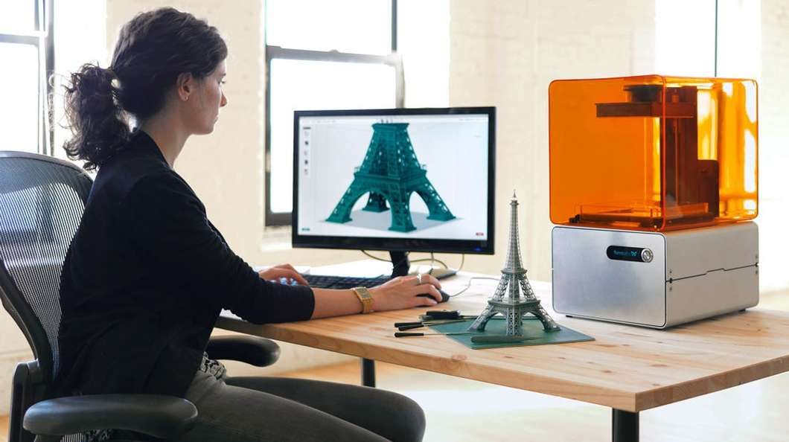
Customer Validation
“That would be the holy grail of 3D printing.”
– Stratasys
“A game changer.” – Formlabs
Notes:
We have continually heard the need for high performance materials throughout the entire supply chain. The 3D printing leaders are all looking for new ways to differentiate themselves and are excited about our game-changing technology. Every manufacturer that makes this type of 3D printer has requested resin samples from us.

Slide 9
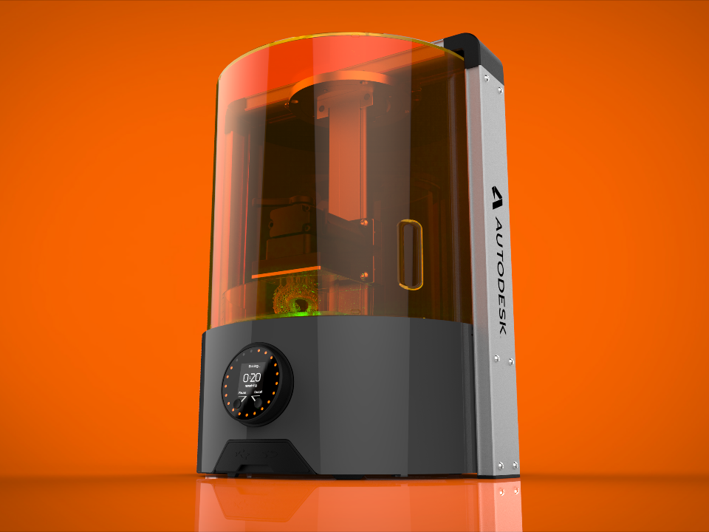
Traction
Partnership with Autodesk
Notes:
We are very excited to announce our first commercial partnership with Autodesk. They have invited us to be a part of their additive manufacturing ecosystem, which will enable us to sell resin directly into an existing customer channel.

Slide 10


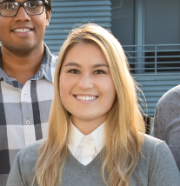
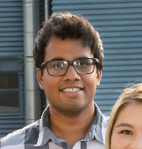
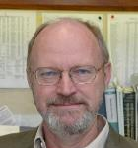


Our Team
Raymond Weitekamp
PhD
Corinne Allen
PhD
Aditya Balasubramanian
PhD
Bob Grubbs
PhD, Nobel Laureate
Founder & CEO
Chemical Operations
Materials Engineering
Scientific Advisor
Notes:
This project came out of a discovery I made during my PhD research at Caltech. Through the Cyclotron Road program, we’ve had the opportunity to assemble a strong technical team to take this all the way from an academic discovery to prototypes of our first product. We’re raising a seed round now to take this technology to market. I hope you’ll stop by our booth to drop bricks on our parts.

Slide 11
We make dreams from goo.
Notes:
At polySpectra, we make dreams from goo. Thank you.

